Slide 1
2021 Cricket T20 World Cup Tweet Analysis
Team Members:
1. Adam Ruther
2. Prasanna Kumar
3. Surabhi Choudhary

Slide 2
Project Description
Social media has evolved as a platform where fans express their feelings towards their favorite sports teams. Our goal is to analyze twitter sentiments discussing the 2021 T20 Cricket World Cup matches which took place in Dubai.
Objective:
Determine if there is a correlation between which team won the match and the sentiment of the tweets that were sent before the game
Measure sentiment accuracy
Visualize sentiment scores

Slide 3
Application Stack
Tools/Libraries used: HTML, Python (Pandas, NumPy, SciPy, Selenium web driver, MeTaPy, visualization packages (Matplotlib), BeautifulSoup, BSI, Text Blob)
Classifier used: Logistic Regression Classifier
Sentiment Analysis: Text Blob used to extract Polarity & Subjectivity scores
Results Visualization: Matplotlib was used to display bar graphs to measure polarity & subjectivity scores

Slide 4
Application Build
Data Collection:
Scraped T20 cricket match schedule from https://www.whereig.com/cricket/t20-world-cup/schedule.html
Official website: https://2021.t20worldcup.com/
Extracted 500K tweets using BSI library with hashtag #T20WorldCup between Sep-Nov 2021
Data Cleanse:
Refined data collection with 100K tweets after merging the match schedule data
Drill down to 25K tweets prior to start of the match
Built classifier to generate initial training using the relevant topics (Predictions only)
Train the classifier from a manually created prediction training set
Built 20+ transformers to create features for classifier
Features include “winner” “will win” “favorites” “predict”
Training model with transformed training set
Accuracy of Logistic regression classifier
Training set accuracy observed > 70%
Test set accuracy observed > 50%
Use classifier to limit 25K tweets to tweets with predictions

Slide 5
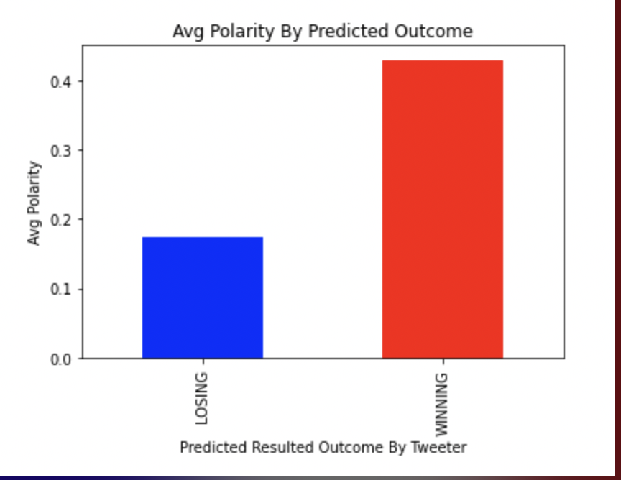
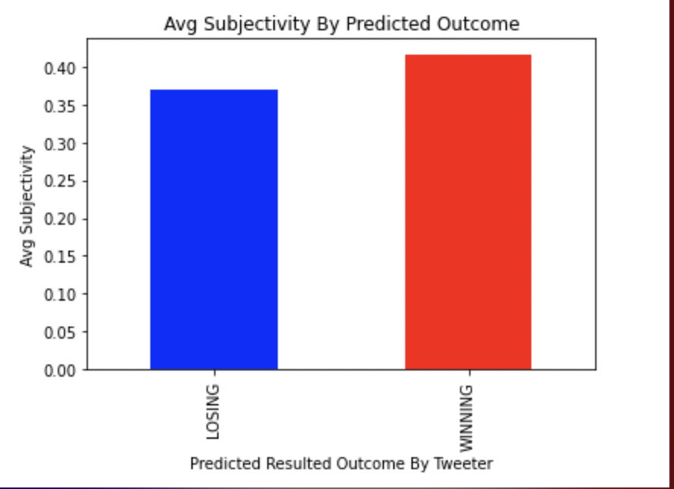
Analysis of Predicted Outcome
POLARITY
SUBJECTIVITY
Analysis of Predicted Outcome:
Manual comparison performed for final set of predicted outcomes with actual match results – Labeled tweets for either “Winning” or “Losing” team
Polarity scores for winning teams' prediction tweets observed to be greater than losing teams’ prediction tweets – Positive statements for winning teams are higher as expected
Subjectivity scores for winning team’s prediction tweets marginally greater than that of losing teams’ - Personal opinions or emotions seem to be higher and doesn’t affect the match outcome if we use this sentiment score

Slide 6
Challenges & Future Improvements
Challenges:
Tweepy API was our first preference to extract tweets, but the API had a limitation as it retrieves only 7 days of past tweets – Not useful for training set
BSI package did not have an option to retrieve tweets using both date & time – Date timestamp range useful for cleansing training set
Future Improvements:
Additional features can be built for classification model to improve accuracy (e.g., Tweet geo location )
Support other languages
Use more social media data sources for improved sentiment accuracy & prediction outcomes

Slide 7
DEMO
LINK TO PRESENTATION: https://mediaspace.illinois.edu/media/t/1_1lswv7yg

